Slide 1

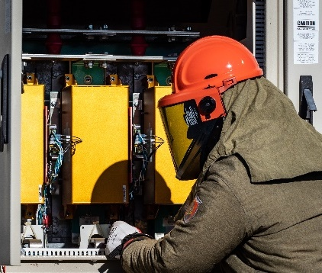
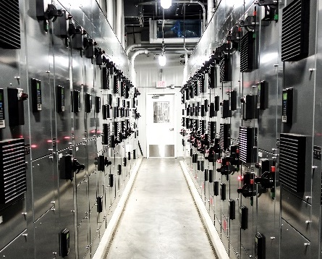


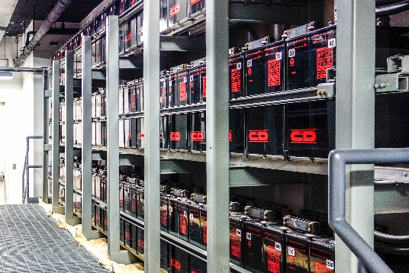
Energy Storage and Microgrid
Training and Certification
ESAMTAC
Module 4:
Battery Safety

Slide 2
Introduction
This module focuses on the unique safety issues associated with Lead Acid and Li-Ion batteries.
Applicable codes governing safety are presented. Development of Job Hazard Analysis and use of personal protective equipment (PPE) are discussed.
The design and use of emergency action plans are discussed as an instrument to synthesize hazard analysis and safety planning.

Slide 3
Learning Objectives
Recall relevant codes and standards that apply to ESM safety
Identify existing and predictable hazards associated with specific battery chemistries
Identify unique failure mode hazards of Lead Acid and Li-Ion batteries
Recognize fire risks associated with batteries
Identify PPE based on shock and arc fault risk assessment
Identify appropriate PPE for chemical hazards
Describe use of spill kits for Lead Acid batteries
Recall principles of Electrical Safe Work Condition
Describe how work plan / method of procedure affects arc fault and shock risk assessment

Slide 4
Organization
Part 4A: Battery Safety & Lead Acid Battery Hazards
Part 4B: Lithium-Ion Battery Hazards
Part 4C: Job Hazard Analysis
Part 4D: Fire Hazards & Emergency Action Plans

Slide 5
Organization
Part 4A: Battery Safety & Lead Acid Battery Hazards
Part 4B: Lithium-Ion Battery Hazards
Part 4C: Job Hazard Analysis
Part 4D: Fire Hazards & Emergency Action Plans

Slide 6
Safety: General
Material Handling and Storage
Pre-work inspections for egress paths, trip hazards, and combustible materials
Clearance as required by OSHA 1926.250(a)(3) for material (battery) handling equipment
Load rating of floors per OSHA 1926.250(a)(2)
Protection of batteries from damage during storage and installation
Is storage within the building necessary or desirable prior to installation?
Notes:
Minimum egress aisle widths as required by OSHA (see 29CFR1910 and/or 29CFR1926 [B23]) or other local applicable codes
1926.250(a)(2)(i)The weight of stored materials on floors within buildings and structures shall not exceed maximum safe load limits.
1926.250(a)(2)(ii)Employers shall conspicuously post maximum safe load limits of floors within buildings and structures, in pounds per square foot, in all storage areas, except when the storage area is on a floor or slab on grade. Posting is not required for storage areas in all single-family residential structures and wood-framed multi-family residential structures.
1926.250(a)(3)Aisles and passageways shall be kept clear to provide for the free and safe movement of material handling equipment or employees. Such areas shall be kept in good repair.

Slide 7
Hazard and Risk Analysis of battery systems
Categories of risk
Chemical
Electrical (Module 7)
Ergonomics (Module 9)
Thinking practice:
Define Task
Identify Hazard
Impact to Health?
Likeli-hood?
Measures required (reduce risk THEN PPE)

Slide 8
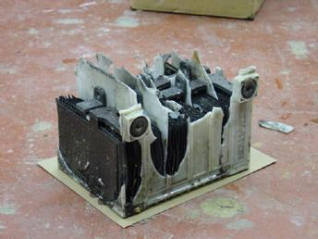
Safety: Lead Acid
Hydrogen gas hazards
By-product of battery charging process but may be present or released even when batteries are not actively charging
Flammable and potentially explosive between 4% and 75% by volume of air
Lighter than air
Migrates and dissipates easily
Exploded lead acid battery [1]
Notes:
Source:
[1] : http://www.aa1car.com/library/battery_exploded.jpg
[2] : http://www.boatus.com/Assets/www.boatus.com/magazines/seaworthy/2012/1Jan/img/hazards01.jpg

Slide 9
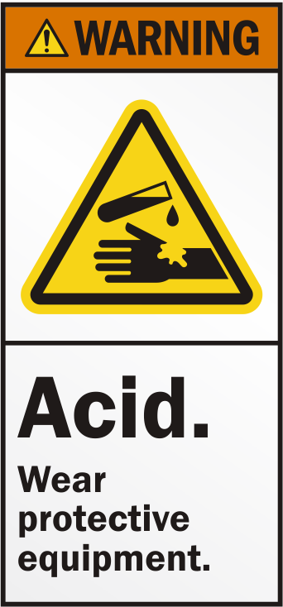
Safety: Lead Acid
Acid Hazards
Mainly sulfuric acid with a pH of less than 2
Sulfuric acid is corrosive, can cause burns to skin and eyes
Hazard may be increased by adding water due to increased volume
May react violently with neutralizing agents
Notes:
Source:
[1] : http://www.aa1car.com/library/battery_exploded.jpg

Slide 10
Safety: Lead Acid
Hydrogen Sulfide (H₂S)
By-product of overcharging and battery decomposition
Highly flammable and toxic
Heavier than air
Rotten egg odor
Emergency course of action, leave the area and use gas detecting instrument with a Hydrogen Sulfide sensor to confirm whether the gas is present before returning
Not a common hazard
Notes:
Source:
https://www.osha.gov/SLTC/hydrogensulfide/hazards.html
http://goodforgas.com/hazardous-gases-associated-lead-acid-battery-charging-stations/

Slide 11

Safety: Lead Acid
Lead and Lead Alloys
Toxic if ingested
Avoid contact or wear gloves
Do not inhale or ingest
Wash hands after handling
Pb
Notes:
Source:
https://www.osha.gov/SLTC/hydrogensulfide/hazards.html
http://goodforgas.com/hazardous-gases-associated-lead-acid-battery-charging-stations/

Slide 12
Lead Acid Battery Hazards
Hydrogen – produced during charging
Spillage from overheating or freezing due to temperature in storage and installation areas
Spillage due to improper handling or damage to case
Do not tilt more than 10 degrees for VLA batteries
Fire hazard due to leakage of hydrogen gas during storage and charging
Corrosion to nearby objects
Overloading of floors in laydown areas
Notes:
IEEE Std 1187

Slide 13
Lead Acid Battery Hazards
Thermal injury due to shorted terminals
Fire hazard due to shorted terminals
Electric shock hazard possible at higher voltages
Potential for physical injury due to weight and size of batteries
Rigging equipment must be suitable for use with batteries, chemically and electrically
Stacking during storage may damage batteries
Notes:
IEEE Std 1187

Slide 14
Lead Acid Battery Hazard Signs
Damage to jar (case) – crack or puncture
Distortion to jar (case) due to freezing
Damage to terminals
Spilled or leaking electrolyte
Low electrolyte level
Notes:
IEEE Std 1187

Slide 15
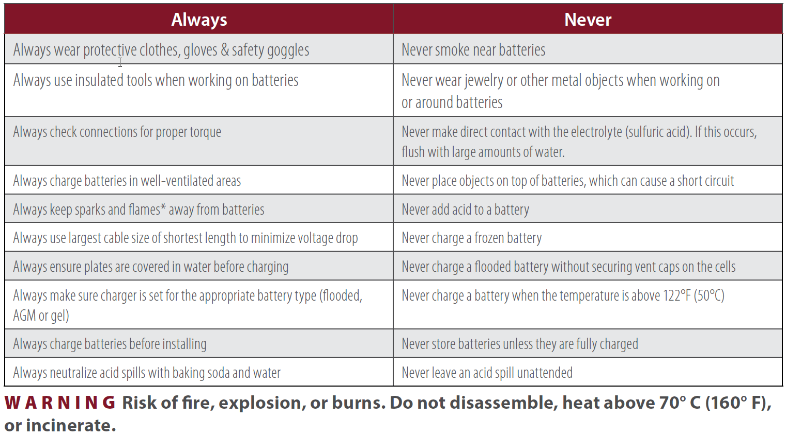
Lead Acid Battery Do’s and Don’ts
[1] Trojan Battery User’s Guide
Notes:
Excerpt from Trojan Battery Company – User’s Guide

Slide 16
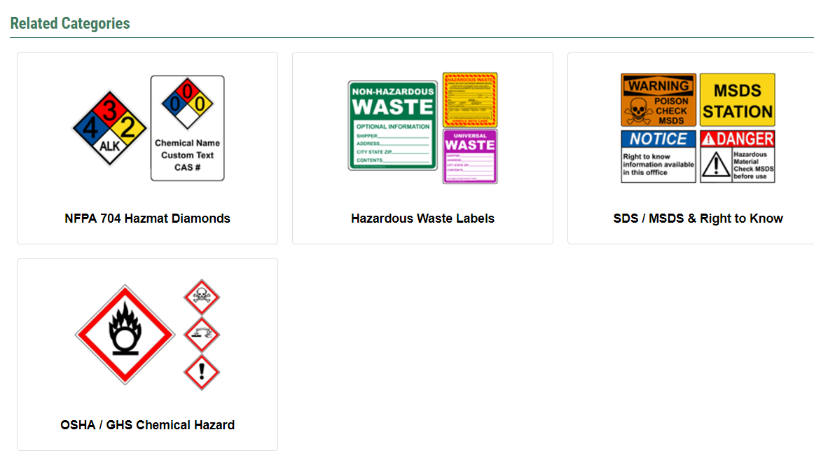
Hazardous Material labeling
Notes:
Safety and signage, perhaps going into or overview of NFPA hazard material warnings. Prepare for others entering the environment.
Over labelling required by NEC for ESS to over 706 in NEC.
Brief note that regionally there may be hazards or issues requiring action or notice external to the actual equipment
snakes, wasps, rats etc.

Slide 17
NFPA 704 Hazardous Material Diamonds
Step One: Select Rating Numbers
Determine each material stored or used at the facility and its warning system category and rating.
Refer to the safety data sheets (SDS) for the materials used.
Hazard Category | Rating Number | Description
Health (Blue) | 4 | Materials that under emergency conditions can be lethal
 | 3 | Materials that under emergency conditions can cause serious injury
 | 2 | Materials that under emergency conditions can cause temporary incapacitation or residual injury
 | 1 | Materials that under emergency conditions can cause significant irritation
 | 0 | Materials that offer no hazard beyond that of ordinary combustible material
Flammability (Red) | 4 | All liquids and gases with a flash point below 73F and a boiling point below 100F
 | 3 | All liquids and gases with flash points at or below 73F and a boiling point at or above 100F and those liquids having flash point at or above 73F and below 100F
 | 2 | All liquids with a flash at or above 100F and below 200F or solids that readily give off vapors
 | 1 | All liquids, solids, and semi solids with flash points at or above 200F
 | 0 | Materials that will not burn, including any material that will not burn in air when exposed to a temperature of 1500F for a period of 5 minutes
Instability (Yellow) | 4 | Materials readily capable of detonation or explosive reaction at normal temperatures and pressures. Includes materials that are very sensitive to heat, shock, or light. Examples would include explosives A & B and organic peroxides
 | 3 | Materials which when heated and under confinement are capable of detonation and which may react violently with water. A "W" should appear as a special hazard if an explosive reaction with water can be expected. Examples would include blasting agents, fireworks, and ammonium nitrate fertilizer
 | 2 | Materials which will undergo a violent chemical change at elevated temperatures and pressures but do not detonate. A "W" should appear as a special hazard if contact with water may cause a violent reaction or may cause potentially explosive mixtures to be formed. Examples would include combustible metals and water reactive corrosive materials
 | 1 | Materials which are normally stable but may become unstable in combination with other materials or at elevated temperatures and pressures. A "W" should appear as a special hazard if a vigorous but not violent reaction with water may take place. Examples would include most common corrosive and oxidizing materials
 | 0 | Materials that in themselves are normally stable, even under fire conditions
Special Hazards (White) |  | Note: Refer to the SDS for the NFPA symbol for each hazard category. Special hazard symbols, such as W (water reactive), OXY (oxidizing material), CRY (cryogenic material), COR (corrosive material), POI (poisonous material), or the radiation warning symbol, must be added to the white bottom section of the placard when available information indicates that one of these special hazards exist. When multiple special hazards exist, add white panels below the placard to list the additional special hazards that apply.
?
?
?
?

Slide 18
NFPA 704 Hazardous Material Diamonds
Hazard Category | Rating Number | Description
Health (Blue) | 4 | Materials that under emergency conditions can be lethal
 | 3 | Materials that under emergency conditions can cause serious injury
 | 2 | Materials that under emergency conditions can cause temporary incapacitation or residual injury
 | 1 | Materials that under emergency conditions can cause significant irritation
 | 0 | Materials that offer no hazard beyond that of ordinary combustible material
Flammability (Red) | 4 | All liquids and gases with a flash point below 73F and a boiling point below 100F
 | 3 | All liquids and gases with flash points at or below 73F and a boiling point at or above 100F and those liquids having flash point at or above 73F and below 100F
 | 2 | All liquids with a flash at or above 100F and below 200F or solids that readily give off vapors
 | 1 | All liquids, solids, and semi solids with flash points at or above 200F
 | 0 | Materials that will not burn, including any material that will not burn in air when exposed to a temperature of 1500 for a period of 5 minutes

Slide 19
NFPA 704 Hazardous Material Diamonds
Hazard Category | Rating Number | Description
Instability (Yellow) | 4 | Materials readily capable of detonation or explosive reaction at normal temperatures and pressures. Includes materials that are very sensitive to heat, shock, or light. Examples would include explosives A & B and organic peroxides
 | 3 | Materials which when heated and under confinement are capable of detonation and which may react violently with water. A "W" should appear as a special hazard if an explosive reaction with water can be expected. Examples would include blasting agents, fireworks, and ammonium nitrate fertilizer
 | 2 | Materials which will undergo a violent chemical change at elevated temperatures and pressures but do not detonate. A "W" should appear as a special hazard if contact with water may cause a violent reaction or may cause potentially explosive mixtures to be formed. Examples would include combustible metals and water reactive corrosive materials
 | 1 | Materials which are normally stable but may become unstable in combination with other materials or at elevated temperatures and pressures. A "W" should appear as a special hazard if a vigorous but not violent reaction with water may take place. Examples would include most common corrosive and oxidizing materials
 | 0 | Materials that in themselves are normally stable, even under fire conditions
Special Hazards (White) |  | Note: Refer to the MSDS for the NFPA symbol for each hazard category. Special hazard symbols, such as W (water reactive), OXY (oxidizing material), CRY (cryogenic material), COR (corrosive material), POI (poisonous material), or the radiation warning symbol, must be added to the white bottom section of the placard when available information indicates that one of these special hazards exist. When multiple special hazards exist, add white panels below the placard to list the additional special hazards that apply.

Slide 20
NFPA 704 Hazardous Material Diamonds
Step Two: Determine the Need for Placards
Compare the total amount of materials with the same hazard category number to the amount requiring placards for each hazard category number.
Building/Facility Placards
Facility and building placards identify the highest hazard rating in each category based on the combined materials in a category rating exceeding threshold quantities. Placards will be required when the following amounts of materials are stored or used at a facility:
Hazard Category | Rating Number | Amount Requiring Placarding on a Building or within a Facility (Aggregate Totals of Weight or Volume)
Health (Blue) | 4 | > 100 lbs. or 10 gals. or 50 cu.ft.
 | 3 | > 100 lbs. or 10 gals. or 50 cu.ft.
 | 2 | > 500 lbs. or 55 gals. or 1000 cu.ft.
 | 1 | > 1000 lbs. or 110 gals. or 200 cu.ft.
Flammability (Red) | 4 | > 500 lbs. or 55 gals. or 1000 cu.ft.
 | 3 | > 500 lbs. or 55 gals. or 1000 cu.ft.
 | 2 | > 1000 lbs. or 110 gals. or 2000 cu.ft.
 | 1 | > 2000 lbs. or 220 gals. or 4000 cu.ft.
Reactivity (Yellow) | 4 | > 100 lbs. or 10 gals. or 50 cu.ft.
 | 3 | > 100 lbs. or 10 gals. or 50 cu.ft.
 | 2 | > 500 lbs. or 55 gals. or 1000 cu.ft.
 | 1 | > 1000 lbs. or 110 gals. or 1000 cu.ft.
?
?
?
?

Slide 21
NFPA 704 Hazardous Material Diamonds
Step Two: Determine the Need for Placards
Compare the total amount of materials with the same hazard category number to the amount requiring placards for each hazard category number.
Subdivision Placards
Subdivisions (rooms or compartments) of buildings or areas within a facility will be placarded to indicate the greatest possible hazards within those subdivisions. Placards will be required when the following amounts of materials are stored or used in a subdivision:
Hazard Category | Rating Number | Amount Requiring Placarding on a Building or within a Facility (Aggregate Totals of Weight or Volume)
Health (Blue) | 4 | Any amount
 | 3 | Any amount
 | 2 | > 100 lbs. or 10 gals. or 50 cu.ft.
 | 1 | > 500 lbs. or 55 gals. or 1000 cu.ft.
Flammability (Red) | 4 | > 100 lbs. or 10 gals. or 50 cu.ft.
 | 3 | > 100 lbs. or 10 gals. or 50 cu.ft.
 | 2 | > 500 lbs. or 55 gals. or 1000 cu.ft.
 | 1 | > 1000 lbs. or 110 gals. or 2000 cu.ft.
Reactivity (Yellow) | 4 | Any amount
 | 3 | Any amount
 | 2 | Any amount
 | 1 | Any amount
?
?
?
?

Slide 22
NFPA 704 Hazardous Material Diamonds
Step Three: Make and Place the Placards
At least 15”x15”
Diamonds 7.5”x7.5”
Subdivision placards may be smaller, typically 8”x8”
Placards shall be affixed to buildings or areas within the facility on each side where entry can be made at an appropriate height to be easily seen from approaching emergency equipment.
A placard must be placed at the property line on a facility gate or post if a placarded building or area within a facility cannot be easily seen when approaching the property.
Affix subdivision placards next to access points into the subdivisions.
These placards must be visible when doors into subdivisions are opened or closed.
2
4
3
COR

Slide 23
NFPA 704 Hazardous Material Diamonds
Activity- Determine placard requirements for the Building 7R system
Step One: Select Rating Numbers
Determine each material stored or used at the facility and its warning system category and rating.
?
?
?
?

Slide 24
NFPA 704 Hazardous Material Diamonds
Activity- Determine placard requirements for the Building 7R system
Step One: Select Rating Numbers
Determine each material stored or used at the facility and its warning system category and rating.
Refer to the safety data sheets (SDS) for the materials used.
0
3
2
COR
Notes:
From Enersys SDS Sheet.

Slide 25
NFPA 704 Hazardous Material Diamonds
Activity- Determine placard requirements for the Building 7R system
Step One: Select Rating Numbers
Determine each material stored or used at the facility and its warning system category and rating.
Refer to the safety data sheets (SDS) for the materials used.
0
3
2
COR
W
Notes:
If sulfuric acid were stored on-site in a concentrated form the W could be necessary.

Slide 26
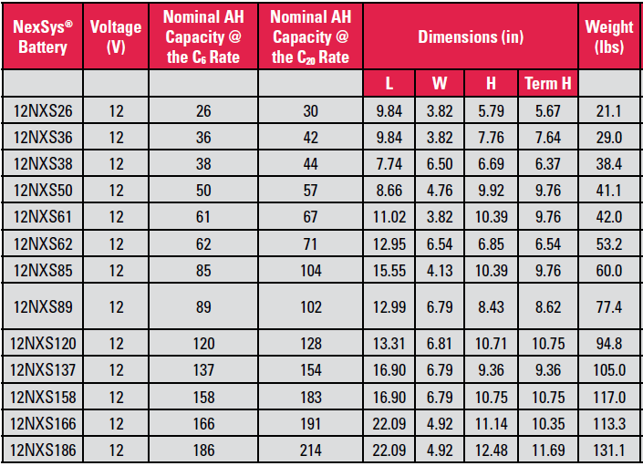
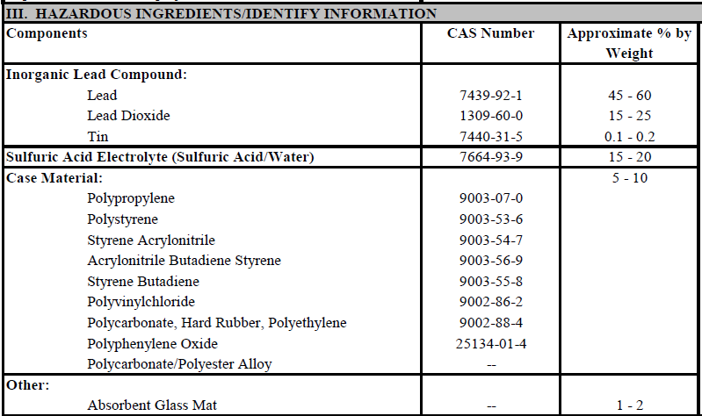
NFPA 704 Hazardous Material Diamonds
Activity- Determine placard requirements for the Building 7R system
Step Two: Determine the Need for Placards
First, you must determine the amount of substance present!
5 rows x 9 batteries x 4 enclosures = 180 batteries
180 batteries x 131.1 lbs. = 23,598 lbs. total
23,598 lbs. x 20% = 4,719.6 lbs. of electrolyte

Slide 27

NFPA 704 Hazardous Material Diamonds
Step Two: Determine the Need for Placards
Compare the total amount of materials with the same hazard category number to the amount requiring placards for each hazard category number.
Building/Facility Placards
Facility and building placards identify the highest hazard rating in each category based on the combined materials in a category rating exceeding threshold quantities. Placards will be required when the following amounts of materials are stored or used at a facility:
4,719.6 lbs. of electrolyte
Hazard Category | Rating Number | Amount Requiring Placarding on a Building or within a Facility (Aggregate Totals of Weight or Volume)
Health (Blue) | 4 | > 100 lbs. or 10 gals. or 50 cu.ft.
 | 3 | > 100 lbs. or 10 gals. or 50 cu.ft.
 | 2 | > 500 lbs. or 55 gals. or 1000 cu.ft.
 | 1 | > 1000 lbs. or 110 gals. or 200 cu.ft.
Flammability (Red) | 4 | > 500 lbs. or 55 gals. or 1000 cu.ft.
 | 3 | > 500 lbs. or 55 gals. or 1000 cu.ft.
 | 2 | > 1000 lbs. or 110 gals. or 2000 cu.ft.
 | 1 | > 2000 lbs. or 220 gals. or 4000 cu.ft.
Reactivity (Yellow) | 4 | > 100 lbs. or 10 gals. or 50 cu.ft.
 | 3 | > 100 lbs. or 10 gals. or 50 cu.ft.
 | 2 | > 500 lbs. or 55 gals. or 1000 cu.ft.
 | 1 | > 1000 lbs. or 110 gals. or 1000 cu.ft.
0
3
2
N/A
COR

Slide 28
Organization
Part 4A: Battery Safety & Lead Acid Battery Hazards
Part 4B: Lithium-Ion Battery Hazards
Part 4C: Job Hazard Analysis
Part 4D: Fire Hazards & Emergency Action Plans

Slide 29
Safety: Li-Ion
Electrolyte Leakage
Electrolyte may be flammable or toxic
Elemental lithium in contact with moisture can cause fire
Uncommon in Li-Ion due to low lithium concentration
Galvanic corrosion of cell casing may cause leakage
Avoid contact with dissimilar metals
Avoid storage in damp areas
May be caused by puncture or damage
May require hazmat remediation
Notes:
Source: MSDS 18650 Lithium-ion Battery

Slide 30
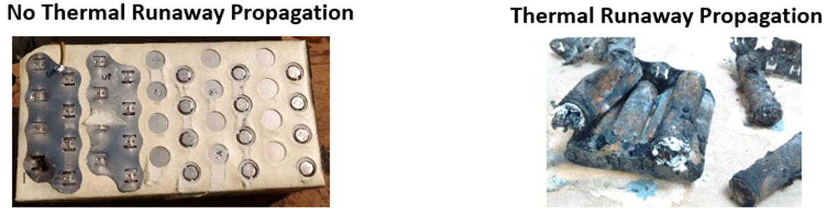
Safety: Li-Ion
Thermal Runaway
Some chemistries unstable above 265 deg F
May explode if thermal runaway occurs
Thermal runaway may propagate throughout blocks, packs and modules
Notes:
Source: MSDS 18650 Lithium-ion Battery
Los Alamos, National laboratory, Lithium Ion Battery Safety, Lioyd Gordan, Nicole Graham

Slide 31
Safety: Li-Ion
Thermal Runaway
May be caused by excessive charge and discharge rates and depths
May be caused by defective cells
May be caused by puncture or damage
May be caused by short circuiting
Accidental grounding of a battery bank can create a hazardous voltage between the ungrounded terminals and ground
Notes:
Source: MSDS 18650 Lithium-ion Battery
Los Alamos, National laboratory, Lithium Ion Battery Safety, Lioyd Gordan, Nicole Graham

Slide 32
Safety: Li-Ion
Thermal Injury Hazards
May be caused by excessive charge and discharge rates – overheating
May be caused by defective cells - overheating
May be caused by puncture or damage - arcing
May be caused by short circuiting – burns
Low internal resistance = high fault currents
Low self-discharge rates maintain potential hazards for long time periods
Notes:
Source: MSDS 18650 Lithium-ion Battery
Los Alamos, National laboratory, Lithium Ion Battery Safety, Lioyd Gordan, Nicole Graham

Slide 33
Li-ion Battery Hazards
Overvoltage
May cause mechanical failure of cell structure
May cause internal shorting
May cause electrolyte decomposition leading to thermal runaway
ALL OF THESE MAY RESULT IN ARCING AND THE SUDDEN RELEASE OF MOLTEN METAL AND FLAMMABLE AND/OR TOXIC ELECTROLYTE AND GASSES
May cause overheating, compromising packaging leading to premature capacity loss
Notes:
Source: DNV-GL, Recommended Practice, Safety, operation and performance of grid-connected energy storage systems, Edition December 2015

Slide 34
Li-ion Battery Hazards
Under voltage
Over discharge can cause internal damage
Applying excessive charge to an over-discharged Li-Ion battery can result in overheating and fire
Proper charger circuitry should prevent this
Typical cell voltage is 3.7v
Below 2.5v is considered damaged – DO NOT RECHARGE!
Notes:
Source: DNV-GL, Recommended Practice, Safety, operation and performance of grid-connected energy storage systems, Edition December 2015

Slide 35
Li-ion Battery Hazard Signs
Damaged or distorted cells, packs or modules
Discoloration
Corrosion
Visible signs of overheating or burning
Visible leakage of electrolyte
Visible failure of spot-welded connections
Visible damage to or failure of BMS components
Cell voltage below 2.5 Volts
Notes:
Source: DNV-GL, Recommended Practice, Safety, operation and performance of grid-connected energy storage systems, Edition December 2015

Slide 36
Li-ion Battery Do’s
Protect Li-Ion batteries from damage
Physical, heat, sunlight, ignition
Store in a dry location @ 0 to 35°C (32 to 95°F)
Leave in sealed packaging until time of installation
Use only Li-Ion batteries with properly designed and installed BMS safety circuits
Move overheated cells away from combustibles and other Li-Ion batteries
Have a foam, CO2, water or dry chemical extinguisher ready for use per SDS recommendation
Secure properly when moving and transporting
Notes:
Source: DNV-GL, Recommended Practice, Safety, operation and performance of grid-connected energy storage systems, Edition December 2015

Slide 37
Li-ion Battery Don'ts
Do not short-circuit, overcharge, crush, drop, mutilate, penetrate with foreign objects, apply reverse polarity, expose to high temperature or disassemble packs and cells.
Do not charge cells blocks or packs without a proper charger with a Li-Ion algorithm
Do not continue using the battery and/or charger if the pack temperature rises more than 10°C (18°F) on a regular charge.
Do not charge below 0°C
Notes:
Source: DNV-GL, Recommended Practice, Safety, operation and performance of grid-connected energy storage systems, Edition December 2015
Source: Battery University/Cadex

Slide 38
Organization
Part 4A: Battery Safety & Lead Acid Battery Hazards
Part 4B: Lithium-Ion Battery Hazards
Part 4C: Job Hazard Analysis
Part 4D: Fire Hazards & Emergency Action Plans

Slide 39
Job hazard Analysis
Evaluate remediation means
Order of precedence and effectiveness of hazard control is the following:
1. Engineering controls
2. Administrative controls
3. Personal protective equipment (PPE)
Note: PPE is the last step in the analysis!

Slide 40
OSHA 1926.441 Requirements - Batteries
Engineering Controls First!
1926.441(a)(1) Batteries of the unsealed type shall be located in enclosures with outside vents or in well ventilated rooms and shall be arranged so as to prevent the escape of fumes, gases, or electrolyte spray into other areas.
1926.441(a)(2) Ventilation shall be provided to ensure diffusion of the gases from the battery and to prevent the accumulation of an explosive mixture.
1926.441(a)(3) Racks and trays shall be substantial and shall be treated to make them resistant to the electrolyte.
1926.441(a)(4) Floors shall be of acid resistant construction unless protected from acid accumulations.

Slide 41
Administrative Controls – “Job Planning”
Administrative Controls Second!
Job briefing?
Evacuate floors below?
Evacuate spill area?
Isolate/secure area?
Signs
Barricades
What personnel needed?
What personnel permitted?
Locate and test eyewash station?
Can hazard be reduced by scheduling?
Fire/Rescue/HazMat crew standby?

Slide 42
OSHA 1926.441 Requirements - PPE
PPE Selection Last!
1926.441(a)(5) Face shields, aprons, and rubber gloves shall be provided for workers handling acids or batteries.
1926.441(a)(6) Facilities for quick drenching of the eyes and body shall be provided within 25 feet (7.62 m) of battery handling areas.
1926.441(a)(7) Facilities shall be provided for flushing and neutralizing spilled electrolyte and for fire protection.

Slide 43
OSHA 1926.441 Requirements - Charging
1926.441(b) Charging -
1926.441(b)(1) Battery charging installations shall be located in areas designated for that purpose.
1926.441(b)(2) Charging apparatus shall be protected from damage by trucks.
1926.441(b)(3) When batteries are being charged, the vent caps shall be kept in place to avoid electrolyte spray. Vent caps shall be maintained in functioning condition.

Slide 44
OSHA Requirements – Head
1926.100(a) Employees working in areas where there is a possible danger of head injury from impact, or from falling or flying objects, or from electrical shock and burns, shall be protected by protective helmets.

Slide 45
OSHA Requirements – Eye and Face
1926.102(a)(1) The employer shall ensure that each affected employee uses appropriate eye or face protection when exposed to eye or face hazards from flying particles, molten metal, liquid chemicals, acids or caustic liquids, chemical gases or vapors, or potentially injurious light radiation.
NOTE: BOTH EYE AND FACE PROTECTION WILL BE NEEDED WHEN SERVICING WET LEAD ACID BATTERIES OR WHEN ENCOUNTERING LEAKING ELECTROLYTE

Slide 46
PPE: Face – Head - Eyes
Hard Hat – Required by OSHA 1926.100(a)
Safety Glasses – Required at all times on jobsite by OSHA 1926.102(a)(1)
Face Shield – Required by OSHA 1926.441(a)(5) when working with batteries or acids (electrolytes)
Moving, connecting, testing, charging
Chemical goggles – Required by OSHA 1926.102(a)(1) when working with electrolytes
Adding water or performing specific gravity testing

Slide 47

PPE: Face and eye protection
Mandatory use of face shields when handling hazardous waste from an electrolyte spill per IEEE Std 1578
OSHA does not specifically address the requirements of non-lead acid batteries
Face Protection [1]
Notes:
Source: IEEE 1657
[1] : https://encrypted-tbn2.gstatic.com/shopping?q=tbn:ANd9GcTbI9PyEz4opr9YBcc-vHpF7k-CRta_jp8XDOTg43GKynePHfM&usqp=CAE
[2] : https://images-na.ssl-images-amazon.com/images/I/41hN6dJ99fL._SY355_.jpg

Slide 48

PPE: Gloves – Lead acid
Primary hazard – Sulfuric Acid
Many options available, but none that are voltage AND chemical rated.
Acid resistant gloves [1]
Notes:
[1] :https://guideimg.alibaba.com/images/shop/2016/08/06/46/mapa-chemzoil-nl-339-neoprene-heavyweight-glove-chemical-resistant-0.050-thickness-14-length-size-10-black-case-of-6-pai_22910346.jpeg
[2] : http://www.cablejoints.co.uk/images/gallery/uploads/1379675382_Insulating%20Gloves.jpg

Slide 49
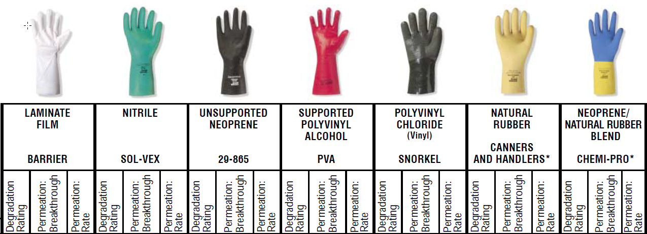
PPE: Gloves
Notes:
Source: Ansell Occupational Health Care - Chemical Resistance Guide – 7th Edition

Slide 50
NFPA 70E - Definition
Electrical Hazard. A dangerous condition such that contact or equipment failure can result in electric shock, arc flash burn, thermal burn, or blast.
Always consider the potential for burn injury when determining the need for PPE

Slide 51
ARC Flash Increases with Enclosure
Notes:
Arc flash and shock PPE may be required to put the battery in a segmented state. The battery must also be isolated from the system.
This only applies if the technician cannot reasonably reach across more than 100 volts or if the exposed parts are protected so the technician cannot touch across more than 100 volts.
If the battery terminals are more than 6 feet apart, or if at least one of the terminals is protected, arc flash PPE is not required with respect to the battery terminal risk.
There may be additional procedures that can be implemented that would further reduce the arc hazard risk and required PPE.
Notes:
IEEE PPE Flow Chart

Slide 52
ARC Flash Increases with Enclosure
Notes:
Arc flash and shock PPE may be required to put the battery in a segmented state. The battery must also be isolated from the system.
This only applies if the technician cannot reasonably reach across more than 100 volts or if the exposed parts are protected so the technician cannot touch across more than 100 volts.
If the battery terminals are more than 6 feet apart, or if at least one of the terminals is protected, arc flash PPE is not required with respect to the battery terminal risk.
There may be additional procedures that can be implemented that would further reduce the arc hazard risk and required PPE.
Notes:
IEEE PPE Flow Chart

Slide 53
PPE for Thermal Hazards: IEEE Std 1187
Those working on or servicing batteries in case of a spark shall use PPE capable of protecting employees from thermal hazards.
The minimum acceptable PPE for thermal hazard shall include thermal hand protection PPE, safety glasses and no jewelry.
If working with the battery system does not include the possibility of sparks, then normal PPE should be used. The use of PPE when servicing batteries shall comply with OSHA requirements .
Notes:
Source: IEEE Std 1187, page no.34

Slide 54
ARC Flash Increases with Enclosure
Notes:
Arc flash and shock PPE may be required to put the battery in a segmented state. The battery must also be isolated from the system.
This only applies if the technician cannot reasonably reach across more than 100 volts or if the exposed parts are protected so the technician cannot touch across more than 100 volts.
If the battery terminals are more than 6 feet apart, or if at least one of the terminals is protected, arc flash PPE is not required with respect to the battery terminal risk.
There may be additional procedures that can be implemented that would further reduce the arc hazard risk and required PPE.
Notes:
IEEE PPE Flow Chart

Slide 55
PPE for Chemical Hazards
Those working on or servicing batteries in case of chemical hazards shall use PPE capable of protecting employees from acid splashes.
The minimum acceptable PPE for chemical hazards shall include acid-resistant gloves, aprons, and chemical-splash goggles. A full-face shield may also be used; however, it should not be worn in place of goggles.
When conditions necessitate, PPE should be FR. The use of PPE when servicing batteries shall comply with OSHA requirements . Safety showers and eyewash stations are also required.
Notes:
AR: Arc Rated
Source: https://energy.gov/sites/prod/files/2016/03/f30/DOE-HDBK-1092-2013.pdf

Slide 56

PPE: Clothing
Aprons (acid-resistant)
Sleeves (acid-resistant)
Protective footwear
[1]
Notes:
Source: IEEE 1657
[1] : https://encrypted-tbn1.gstatic.com/shopping?q=tbn:ANd9GcTq0lya3q7EZaXRiq8HlN4UDR7saqJql_6pOGZBkrSysV33isY1&usqp=CAE
[2] : https://encrypted-tbn1.gstatic.com/shopping?q=tbn:ANd9GcSDm-LVMUkCrVJvn0E5D8BzGaWvnWA6gq1pd8WRXnX5zhMP0qbLq1tsfuanMQSdK-y0jFGANDs4&usqp=CAE

Slide 57
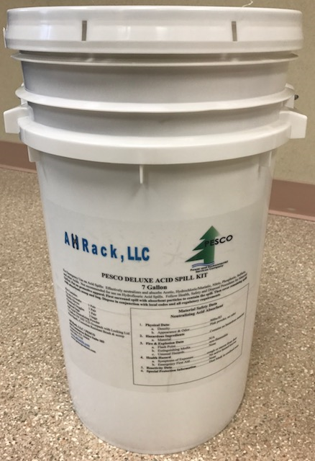
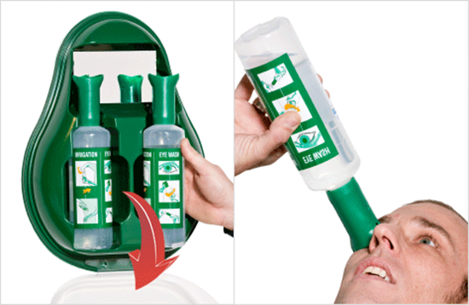
PPE: Equipment
Spill kit
Eye wash station
Drench Shower
Spill Kit [1]
Portable eyewash [2]
Notes:
[2] : http://www.alsco.com.au/wp-content/uploads/2014/02/alsco-eyewash-station-application.png

Slide 58
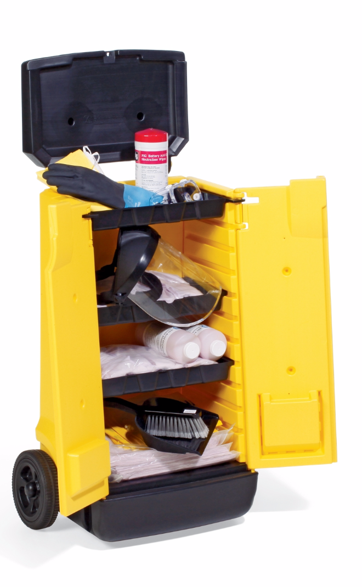
Electrolyte Spill Kit - Usage
https://www.youtube.com/watch?v=noRe87GWIqI
Common Items
Neutralizing agents
Disposal bags
Gloves
Goggles
Face shield
Apron/Coveralls
Notes:
Precautions should be taken to protect personnel with the proper safety equipment when working with batteries and electrolyte. See the following list of recommended equipment to be kept on hand (for use by trained, authorized personnel only):
-Chemical goggles and face shield
-Chemically resistant apron
-Chemically resistant gloves and sleeves
-Chemically resistant boots or overshoes
-Portable or stationary water facilities for rinsing eyes and skin in case of contact with electrolyte
(the use of pH-buffered neutralizing eyewash solution is recommended)
-Air-purifying respirators for electrolyte vapors and mist
-Absorption material, neutralization material, or a combination of the two
-“Flat-head” or “flat-nose” shovel4
-Brush
-Chemically resistant container to safely store materials until proper disposal
Eye protection (chemical goggles and face shield) is of particular concern, as both sulfuric acid and potassium hydroxide may permanently damage the eyes. Portable or permanent eyewash stations (including safety boards with buffered solution bottles) and/or showers are required by IEEE standards relating to the installation and maintenance of lead-acid and Ni-Cd batteries (see IEEE Std 450, IEEE Std 484, and IEEE Std 11066 ). Rinsing each affected eye with copious amounts of water is the appropriate first aid. For potassium hydroxide, a pH-buffered solution is necessary in addition to flushing with water.
Electrolyte vapors may be in the air, especially if spread by firefighting, or by exothermic neutralizing reactions. Air-purifying respirators for personnel are recommended to protect the internal membranes of the eyes, nose, throat, and lungs.

Slide 59
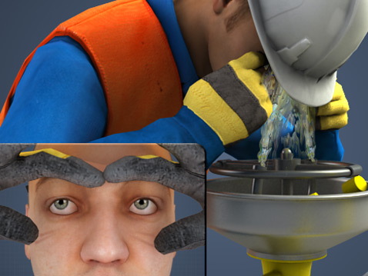
PPE: Eyewashes
Permanent eyewash stations are necessary based on ANSI Z358.1
Permanent eyewash stations should be maintained frequently
Maintaining and using of portable eyewash bottles
Permanent Eyewash station [1]
Notes:
Source: IEEE 1657
[1] :https://www.convergencetraining.com/Images/Courses/safety-shower-eye-wash--two.jpg

Slide 60
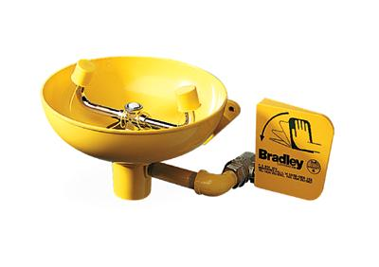
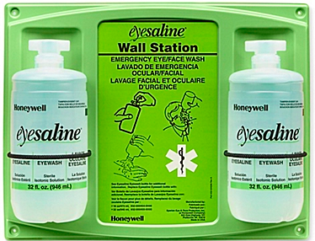
Eye wash
Notes:
Make sure you review the MSDS for eye contact emergencies and have a suitable eyewash stand close by.
The left picture is a permanent eye wash basin and the right is a portable kit.

Slide 61
OSHA Eye wash
29 CFR 1910.151(c), specifies that
"where the eyes or body of any person may be exposed to injurious corrosive materials, suitable facilities for quick drenching or flushing of the eyes and body shall be provided within the work area for immediate emergency use. “
Eyewash and/or safety shower would be required where an employee's eyes or body could be exposed to injurious corrosive materials
Notes:
Make sure you review the MSDS for eye contact emergencies and have a suitable eyewash stand close by.

Slide 62
ARC Flash Increases with Enclosure
Notes:
Arc flash and shock PPE may be required to put the battery in a segmented state. The battery must also be isolated from the system.
This only applies if the technician cannot reasonably reach across more than 100 volts or if the exposed parts are protected so the technician cannot touch across more than 100 volts.
If the battery terminals are more than 6 feet apart, or if at least one of the terminals is protected, arc flash PPE is not required with respect to the battery terminal risk.
There may be additional procedures that can be implemented that would further reduce the arc hazard risk and required PPE.
Notes:
IEEE PPE Flow Chart

Slide 63
Acid Contact from EnerSys Example
In case of sulfuric acid contact with clothing or material
IMMEDIATELY:
REMOVE CONTAMINATED CLOTHING
2. Apply a solution of sodium bicarbonate solution (1.0 lb/1.0 gal or 0.5 kg/5.0 liters of water) on the clothing or material.
3. Apply the solution until bubbling stops, then rinse with clean water.
Notes:
Always review the manufacture’s instructions for safety.

Slide 64
Job Hazard Analysis
Prepare for what is likely to happen
Plan for what might happen
Ask yourself:
What can go wrong?
Where and to who?
What are the consequences?
How could it happen?
How likely is it that the hazard will occur?
What does OSHA require at a minimum?
What does the Safety Data Sheet (SDS) recommend?
What does the equipment manual recommend?

Slide 65
Job Hazard Analysis: Example
Task Description
Moving/Installing VLA “Wet” Lead Acid Batteries
Engineering Controls - Discussion
Dilute
Neutralize
Absorb
Contain
Ventilate
Illuminate
_
_
_
_
Notes:
IEEE Std 1187

Slide 66
Job Hazard Analysis: Example
Task Description
Moving/Installing VLA “Wet” Lead Acid Batteries
Administrative Controls - Discussion
Job briefing?
Evacuate floors below?
Evacuate spill area?
Isolate/secure area?
Signs
Barricades
What personnel needed?
What personnel permitted?
Locate and test eyewash station?
Can hazard be reduced by scheduling?
Fire/Rescue/HazMat crew?

Slide 67
Job Hazard Analysis: Example
Task Description
Moving/Installing VLA “Wet” Lead Acid Batteries
Select the PPE Required - Discussion
Hard Hat
Splash Goggles
Safety Glasses
Face Shield
Acid Resistant Apron
Spill Kit
Acid Resistant Gloves
Fire Extinguisher
Voltage Rated Gloves
Leather Protectors
Leather Gloves
Neutralizing Agent
Safety shoes with acid resistant soles
Eye Wash Station
Drench Shower
Notes:
IEEE Std 1187

Slide 68
Job Hazard Analysis: Example 2
Task Description
Moving/Installing VRLA “Sealed” Lead Acid Batteries
Engineering Controls - Discussion
Dilute
Neutralize
Absorb
Contain
Ventilate
Illuminate
_
_
_
_
Notes:
IEEE Std 1187

Slide 69
Job Hazard Analysis: Example 2
Task Description
Moving/Installing VRLA “Sealed” Lead Acid Batteries
Administrative Controls - Discussion
Job briefing?
Evacuate floors below?
Evacuate spill area?
Isolate/secure area?
Signs
Barricades
What personnel needed?
What personnel permitted?
Locate and test eyewash station?
Can hazard be reduced by scheduling?
Fire/Rescue/HazMat crew?

Slide 70
Job Hazard Analysis: Example 2
Task Description
Moving/Installing VRLA “Sealed” Lead Acid Batteries
Select the PPE Required - Discussion
Hard Hat
Splash Goggles
Safety Glasses
Face Shield
Acid Resistant Apron
Spill Kit
Acid Resistant Gloves
Fire Extinguisher
Voltage Rated Gloves
Leather Protectors
Leather Gloves
Neutralizing Agent
Safety shoes with acid resistant soles
Eye Wash Station
Drench Shower
Notes:
IEEE Std 1187

Slide 71
Job Hazard Analysis – Thought Process
Environmental – Administrative - PPE
Task #: 1
Task description: Four workers will unload 40 VLA batteries from freight truck into jobsite storage container. Forklift access to truck and to storage container. Batteries on 10 pallets of 800 pounds each.
Hazard Type: Chemical
Hazard Description: Spillage of electrolyte
Consequence: Eye and skin injury
Hazard Controls: DISCUSSION
Emergency Plan Steps: DISCUSSION

Slide 72
Job Hazard Analysis – Thought Process
Task #: 1a
Task description: Four workers will unload 40 VLA batteries from freight truck into jobsite storage container. Forklift access to truck and to storage container. Batteries on 10 pallets of 800 pounds each.
Hazard Type: Physical
Hazard Description: Overexertion
Consequence: Strains and/or sprains
Hazard Controls: DISCUSSION
Emergency Plan Steps: DISCUSSION

Slide 73
Job Hazard Analysis
Task #: 14
Task description: Two workers will remove damaged Li-Ion modules from system
Hazard Type: Electrical
Hazard Description: Shock and/or Electrocution
Consequence: Burns and/or Death
Hazard Controls: DISCUSSION
Emergency Plan Steps: DISCUSSION

Slide 74
Job Hazard Analysis
Task #: 14a
Task description: Two workers will remove damaged Li-Ion modules from system
Hazard Type: Fire
Hazard Description: Combustion of damaged pack
Consequence: Ignition of combustibles and adjacent packs. Explosion.
Hazard Controls: DISCUSSION
Emergency Plan Steps: DISCUSSION

Slide 75
Organization
Part 4A: Battery Safety & Lead Acid Battery Hazards
Part 4B: Lithium-Ion Battery Hazards
Part 4C: Job Hazard Analysis
Part 4D: Fire Hazards & Emergency Action Plans

Slide 76
Fire Hazards for ESS
NFPA 855 Annex C – Fire-Fighting Considerations
C.1.1 Emergency Responder Pre-incident Planning
Understanding the procedures included in the facility operation and emergency response plan
Identifying the types of ESS, potential hazards, and methods for responding to fires associated with ESS
Identification of all disconnects, and understanding of energy stored in ESS
Understanding of shutdown and isolation procedures
Procedures for dealing with damaged ESS equipment in post-fire incident
Notes:
Everyone taking the ESAMTAC course should read and become familiar with all of the information present in 855’s Annex C

Slide 77
Fire Hazards for ESS
NFPA 855 Annex C.1.1 cont.
Procedures for dealing with damaged ESS equipment in post-fire incident
Recognizing that stranded electrical energy in ESS has potential for reignition long after initial extinguishment
Contacting personnel qualified to safely remove damaged ESS equipment form the facility
NFPA 855 Annex C.2 General
Handover procedures for potentially damaged systems should be developed for fire departments to ensure the timely response of qualified technical representatives to manage safety issues.
E.g. removal and recycling, stranded energy
Notes:
Individuals taking the ESAMTAC course are likely to be the first call for facilities needed a team of qualified personnel to assist with fire-fighting procedures, before, during, and after a potential fire incident.

Slide 78
855 Annex C
C.3 Suppression Systems
Research and large-scale testing is still needed, but preliminary findings show that lithium-ion systems must be cooled to terminate the thermal runaway process.
Water is the best agent, but cabinets and enclosures create a barrier to efficient application and allows free movement of fire and combustible gases.
Notes:
Individuals taking the ESAMTAC course are likely to be the first call for facilities needed a team of qualified personnel to assist with fire-fighting procedures, before, during, and after a potential fire incident.

Slide 79
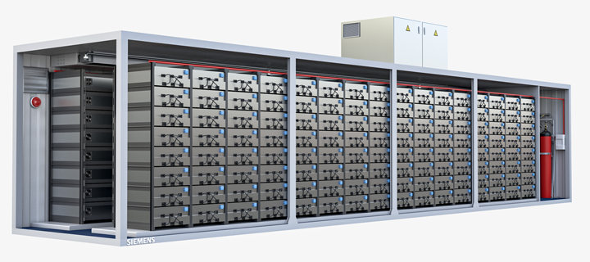
Siemens Approach
Siemens has been conducting testing and certification for their system which utilizes an inert gas agent.
Their research has shown that for lithium-based chemistries, there is a thermal runaway pre-indicator; electrolyte gas. Once the gas has formed, a thermal runaway event is imminent but can still be suppressed.
Their method utilizes aspirating smoke detectors and inert gas (nitrogen) to flood areas that water would not be able to reliably reach.
Notes:
Thermal runaway as a hazard scenario:
Exceeding the safe temperature range can result in what is called “thermal runaway.” When this occurs, the energy stored in the battery is suddenly released, and within milliseconds the temperature rises to many hundred degrees. As a result, the electrolyte ignites or electrolytic gas explodes.
During a thermal runaway event, the electrolyte successively evaporates as the temperature climbs. This causes the pressure inside the cell to increase until the electrolyte vapors are released through a relief valve or a bursting cell wall. Without countermeasures, this results in an explosive gas-air mixture. All it then takes is an ignition source to cause an explosive combustion. In addition, a thermal runaway event in a battery system can spread from cell to cell, leading to a major fire.
Potential causes of thermal runaway can be found outside the battery cell or inside. In the first case, extreme external factors, such as a building fire, can cause the temperature in the battery to rise above the tolerance level. In the second case, an internal short circuit leads to a dangerous temperature increase. The short circuit could be caused by external mechanical damage or age-related separator failure due to dendrite formation.

Slide 80
855 C.4.1 Overheated Batteries
Proper response to an overheated battery should include the following procedures and steps:
Isolate area of all nonessential personnel
Review status of both building and ESS alarm systems with available data
Review status of any fire protection system activation
Perform air monitoring of all connected spaces
Identify location of overheated battery
Isolate affected battery, string, or entire system based on the extent of damage by opening battery disconnect switches, where provided
Contact person or company responsible for operation and maintenance of system
Continue temperature monitoring to ensure mitigation of overheating condition

Slide 81
855 C.4.2 Fires
As the process continues, additional signs might include vent gas ignition, exploding cells, projectile release, heat and flame propagation.
As the failure cascades, be prepared for toxic and potentially explosive gas release. Testing is incomplete but responders should use full suite of PPE and SCBA.
Proper response to electrochemical ESS fires should include the following procedures and steps:
System isolation and shutdown
Hazard confinement and exposure protection
Fire suppression
Ventilation

Slide 82
Design of Emergency Action Plan
Developed in advance
Site specific
Focused on identifiable hazards via
Safety Data Sheets
Operation/Service Documentation
Experience/Observation/Consultation
Task driven (i.e. installing lead-acid)
Location specific
Reviewed periodically or as appropriate

Slide 83
Battery Emergency Types
Spillage/Release of electrolyte
Overheating
Fire
Arcing
Explosion

Slide 84
Eyewash station set up and use
https://youtu.be/OPGyt1M0Bns
Notes:
Note: OSHA Requires Eyewash Station within 25 feet of battery handling area.

Slide 85
Spill Kit Use
https://youtu.be/noRe87GWIqI
Notes:
MSDS:Material Safety Data Sheet
Source: Technical manual for battery, navy lithium safety program responsibilities and procedures

Slide 86
Emergency Action Plan: Leaking Batteries
Refer to SDS for the battery and respond accordingly.
Use of PPE to approach the leaking battery, use chemical resistant gloves, safety glasses, face shield or goggles, and appropriate acid-resistant layers such as aprons when handling leaking batteries.
If the leak is from Li-Ion battery, use extreme caution to cleanup strong acid, other toxic or flammable substances.
Neutralize the acid with baking soda or other base.
Sweep up the absorbent and deposit in a strong doubled plastic.
Place the leaky battery, in a strong plastic bag and pack in an appropriate container.
If in contact with electrolyte, flush with copious amount of water and report immediately to the medical department for treatment.
Notes:
MSDS:Material Safety Data Sheet
Source: Technical manual for battery, navy lithium safety program responsibilities and procedures

Slide 87
Emergency Action Plan: Fire Hazards
Review the SDS to identify the correct fire extinguisher. Have extinguishers available.
Notify local first responder.
Power to the room should be cut.
All doors of the battery storage room should be opened to ensure the safety of the personal who are working on the equipment.
Fire protection system should sound the alarm and start the sprinkler system.
Keep the battery as cool as possible.
Notes:
SDS: Safety Data Sheet
Source: Lessons Learned From Our Fire in Franklin, Author: David Myers, Vice President Power Quality & Energy Storage

Slide 88
Learning Objectives
Recall relevant codes and standards that apply to ESM safety
Identify existing and predictable hazards associated with specific battery chemistries
Identify unique failure mode hazards of Lead Acid and Li-Ion batteries
Recognize fire risks associated with batteries
Identify PPE for chemical hazards
Identify PPE based on shock and arc fault risk assessment
Identify appropriate PPE for chemical hazards
Describe use of spill kits for Lead Acid batteries
Recall principles of Electrical Safe Work Condition
Describe how work plan / method of procedure affects arc fault and shock risk assessment

